Slide 1



Understanding Marine
Microbial Cellular Physiology Under Varying Temperatures and Carbon Sources
Presenter:Yuecheng Liu
(Bioinformatics & Systems Biology)
Supervisor: Matti Gralka
Examiner: Filipe Branco dos Santos
https://xsj.699pic.com/tupian/00yyiv.html

Slide 2


Marine heterotrophic pryokaryotes
Organic Matter Degradation
(Polysaccharide...)
Nutrient Cycling
Environmental conditions
warmer
Colder
Cell Size
metabolic excretions
Cell cize
Growth rates

Slide 3



Environmental conditions matter!
Here, we focused on
Physical conditions: light exposure,osmolarity,temperature, ...
Temperature
Growth media
Enzyme
Metabolic pathways
Growth rate
Notes:
Temperature changes the conformational entropy of proteins, which affects enzyme binding affinity, flexibility, rigidity, and stability of the enzyme-substrate complex, thereby influencing the reaction rate.
Huete-Stauffer et al. [6] found that nucleic acid content and cell size varied seasonally, with a strong negative correlation between growth rates and cell size in warmer spring and summer temperatures. When warming did not increase growth rates (negative activation energies), reductions in cell size and nucleic acid content were minimal or reversed.

Slide 4
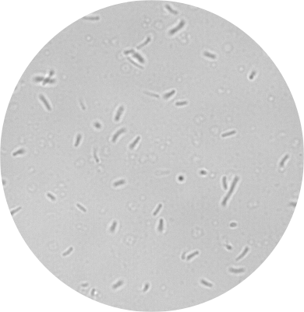
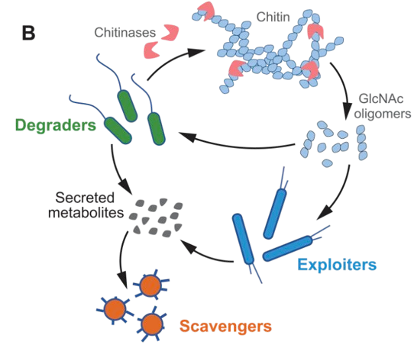
To study the physiology of marine heterotrophic bacteria, we focused on the well-studied strain 1A01
Vibrio splendidus strain 1A01
First identified as an early colonizer of synthetic chitin particles incubated in seawater
Pontrelli, Sammy, et al. "Metabolic cross-feeding structures the assembly of polysaccharide degrading communities." Science advances 8.8 (2022): eabk3076.
It secrets enzymes that break down chitin. ​
Functions as a degrader among 18 solates, collected from natural polymer degrading communities.​
Notes:
Marine heterotrophic bacteria
Decomposition and Nutrient cycling Contribute to the marine food web by decomposing complex organic matter,thereby recycling carbon and nitrogen.
Energy Transfer, Biofilm formation to provide a habitat for other microorganisms, Interaction with other marine organisms etc.
Schematic of functional guilds: Degraders can grow on chitin as a sole carbon source through breakdown of chitin using chitin-degrading enzymes, exploiters can grow on monomeric or oligomeric N-acetylglucosamine (GlcNAc) as a sole carbon source, and scavengers require metabolites secreted by other species to be sustained in the community.

Slide 5



Evaluate the impact of temperature on cell size
Collect a dataset comprising growth rates and metabolic excretions of 1A01 using both plate reader and tubes, considering different temperatures and media.
To supplement the growth measurements
of 1A01, analyzing an existing data of 96
marine strains growth at four temperatures on a variety of carbon sources.
Investigate the temperature sensitivities of the key functional output- exemplified by the activity of chitinase, in the supernatants of 1A01
5
Notes:
Cell cize measurement for 1A01 grown on MB, pyruvate and glucose
microscopy and Fiji analysis
Growth Rate Measurement under various temperatures
1A01 grown on 14 carbon sources and analysis the 96-marine strain dataset (Gralka,2023)
Plate Reader
Tubes
HPLC
Metabolic excretions
Chitinase Assay
Indicated by 4-MU concentration/h

Slide 6
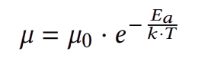
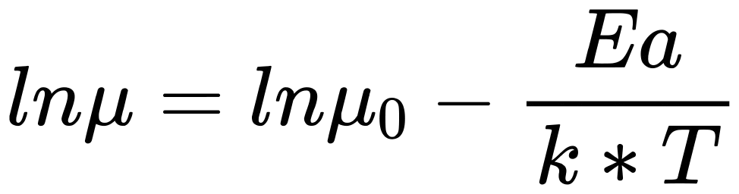
Arrhenius
Law
lnµ(h-1)
lnµ(h-1)
1/T
1/T
warmer
Colder
T↑,µ↑, -Ea /k<0
T↑,µ↓, -Ea/k >0
Cell Size
Ea<0
Reductions in cell size was minimal or reversed Huete-Stauffer et al.(2016).
Huete-Stauffer, Tamara M., et al. "Experimental warming decreases the average size and nucleic acid content of marine bacterial communities." Frontiers in microbiology 7 (2016): 730.
Previous studies found:
Huete-Stauffer et al.(2016) found that cell size varied seasonally, with a strong negative correlation between growth rates and cell size in warmer temperatures. When warming did not increase growth rates (negative activation energies), reductions in cell size and nucleic acid content were minimal or reversed.
Notes:
where k is some biological quantity (e.g., at the molecular level, enzyme reaction rate),
kB is Boltzmann’s constant, T is absolute temperature, E is an effective activation energy
for the process of interest, and a is an overall normalization constant characteristic of
the process. Consequently, a plot of ln(k) vs. 1/T should yield a straight line, often
referred to as an Arrhenius plot. This equation was originally an empirical formulation
but was later motivated heuristically from chemical reaction theory (9) (SI Appendix,
Text S1). Although it has been instrumental in explaining the approximately universal
temperature dependence across many diverse biological rates (2, 4), it cannot account
for the complete pattern of temperature response of different biological traits, including
metabolism and growth rate, among others

Slide 7
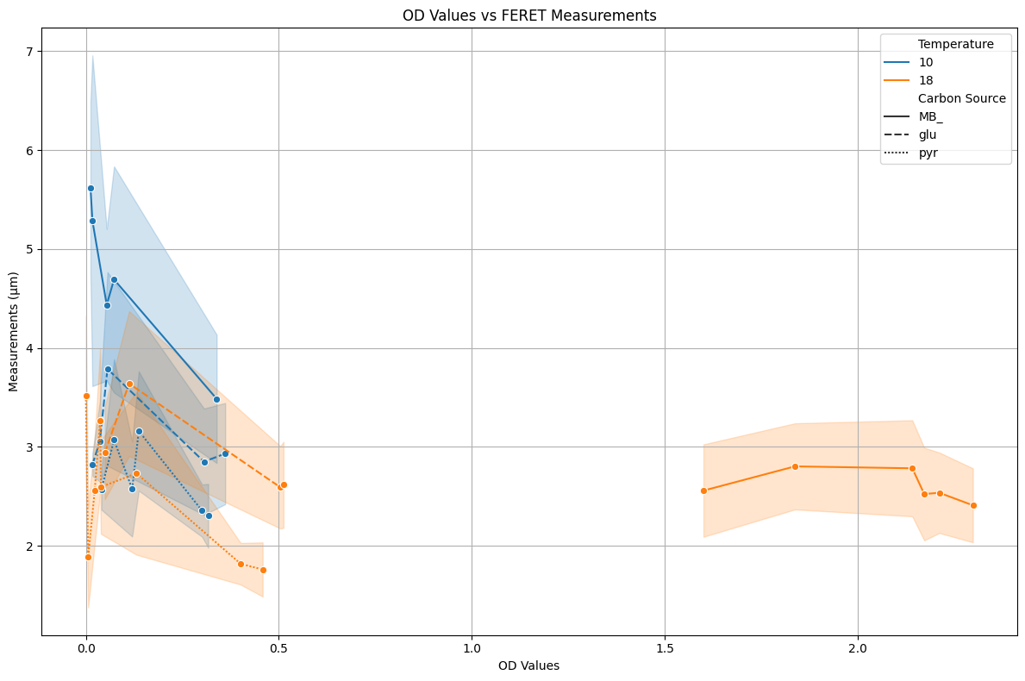
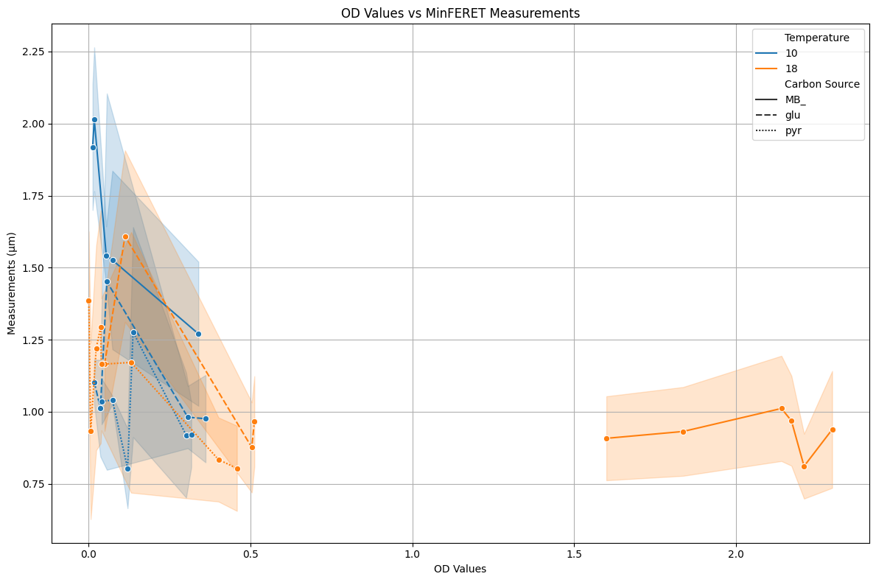
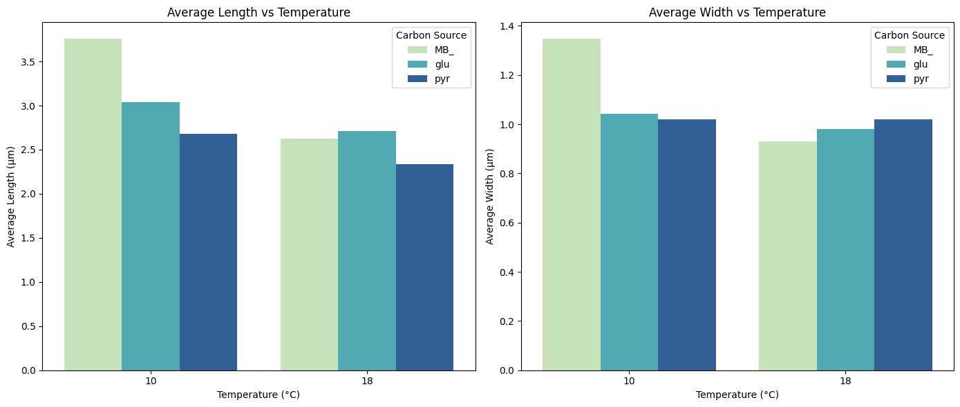
Cell Size Measurement
width(µm)
Length(µm)
OD600
OD600

Slide 8
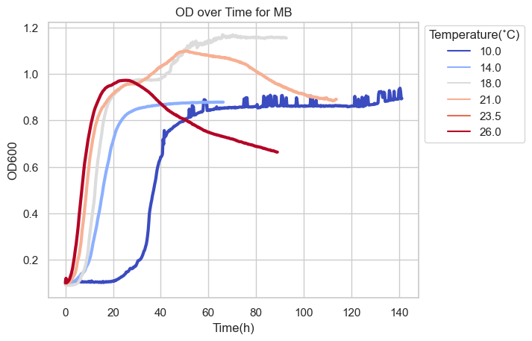
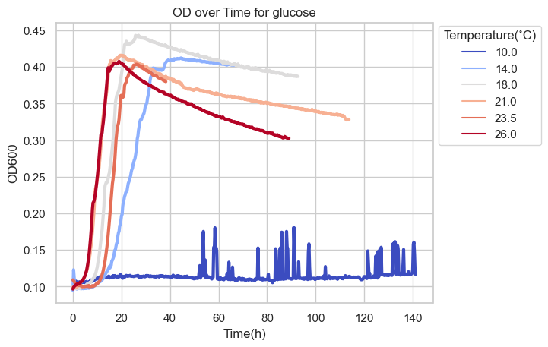
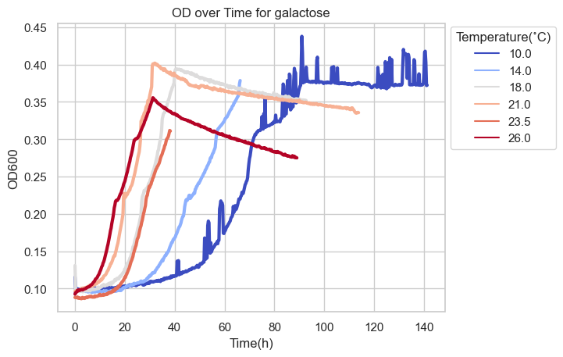
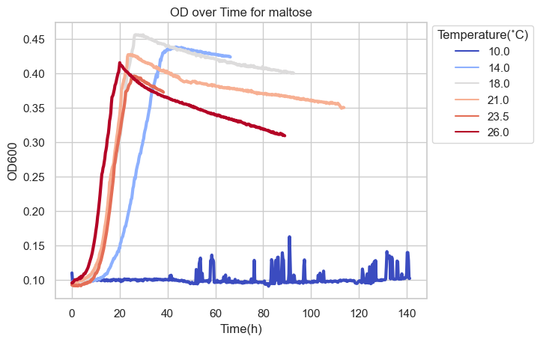
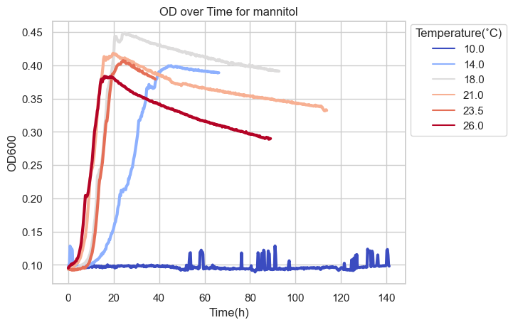
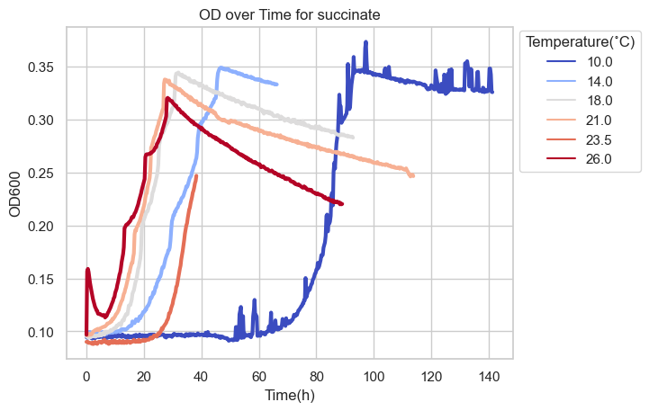
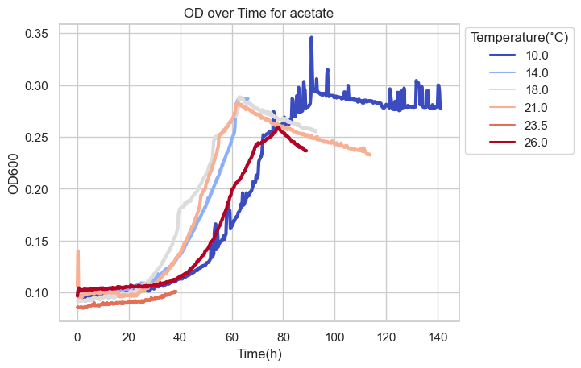
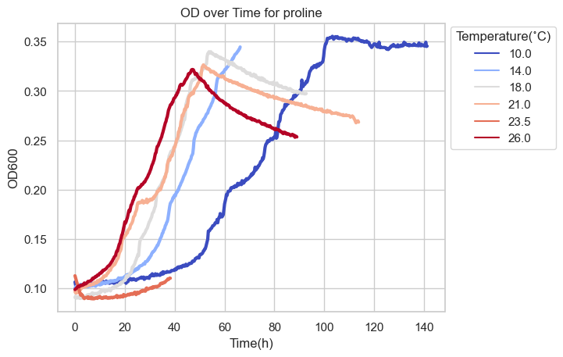
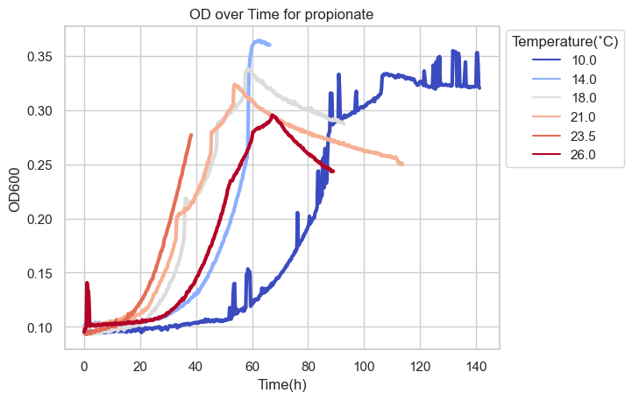
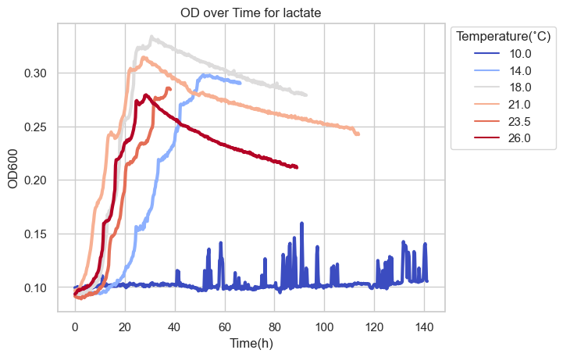
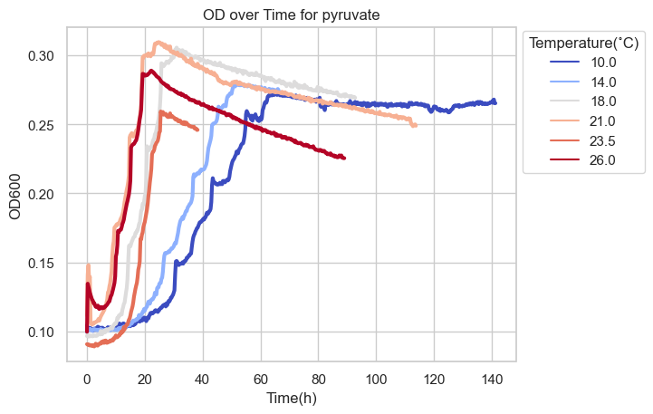
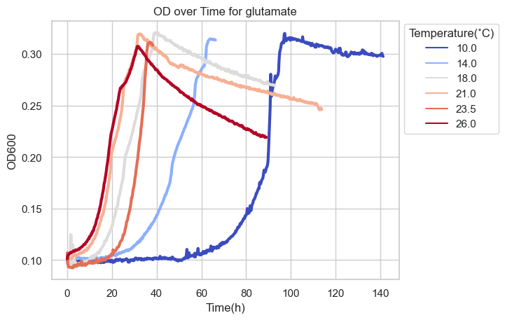
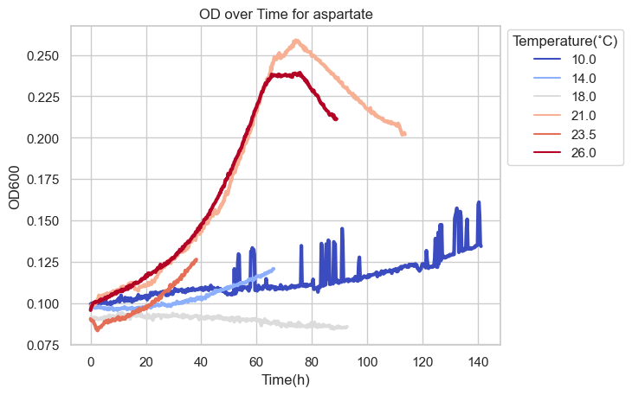
Growth Curves From Plate Reader
Sugars: The highest OD achieved are all around 0.45
Acids: The highest OD achieved are among 0.25~0.35
9
the strain grown on rich media (MB) achieved the maximum optical density. Surprisingly, the strain grown on sugars: glucose, manni- tol, maltose, glycerol, galactose, all reached their highest optical densities around 0.45, ranking second only to MB at the measured temperature range of 18°C-21°C. The least suitable carbon source for 1A01 biomass productivity was aspartate, with the highest achieved OD around 0.25 at 21°C

Slide 9
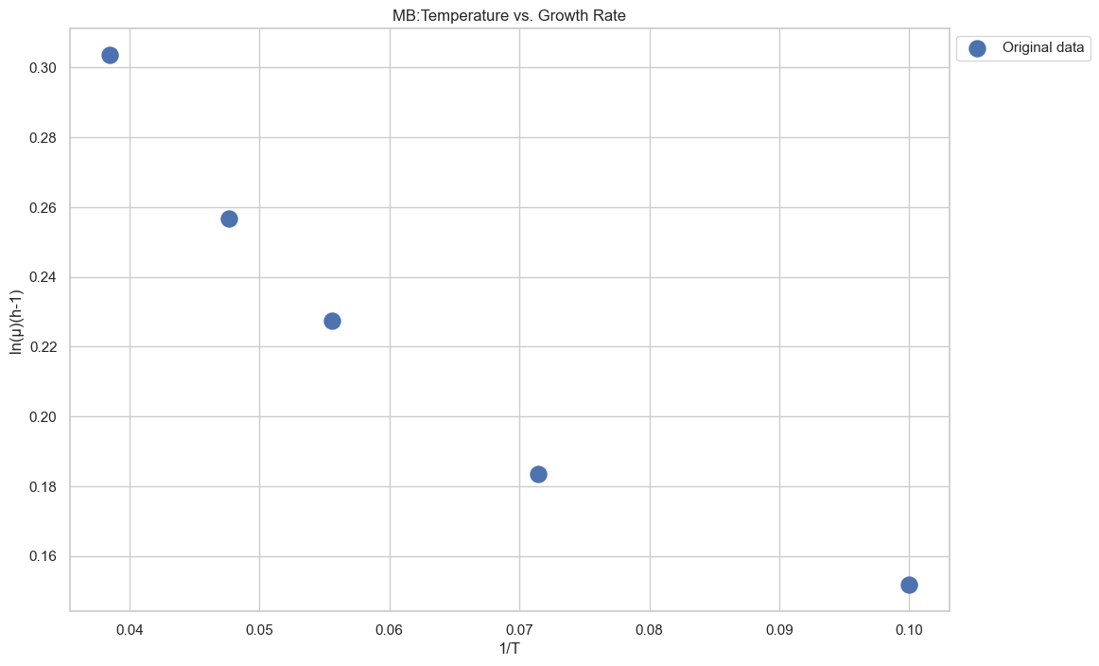
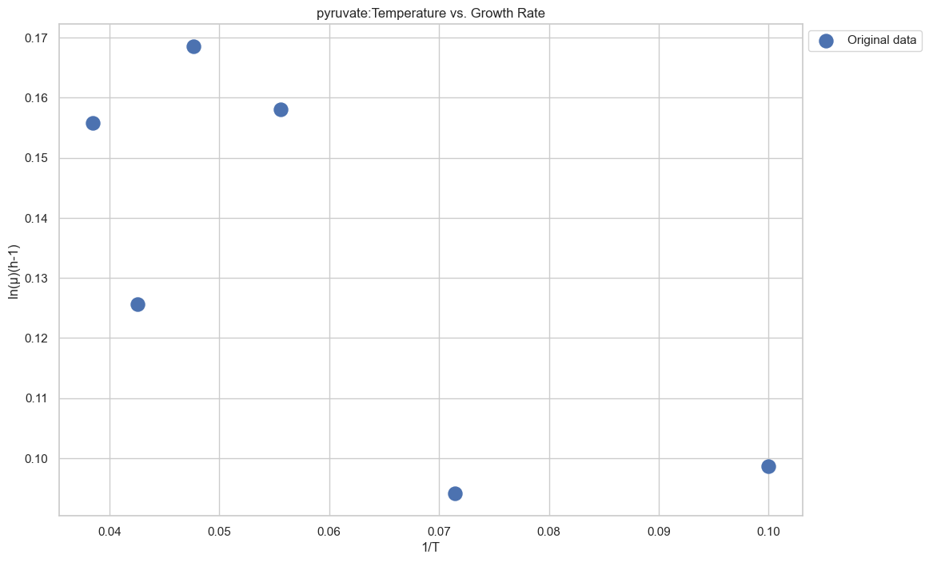
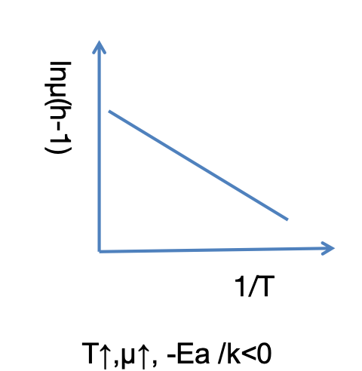
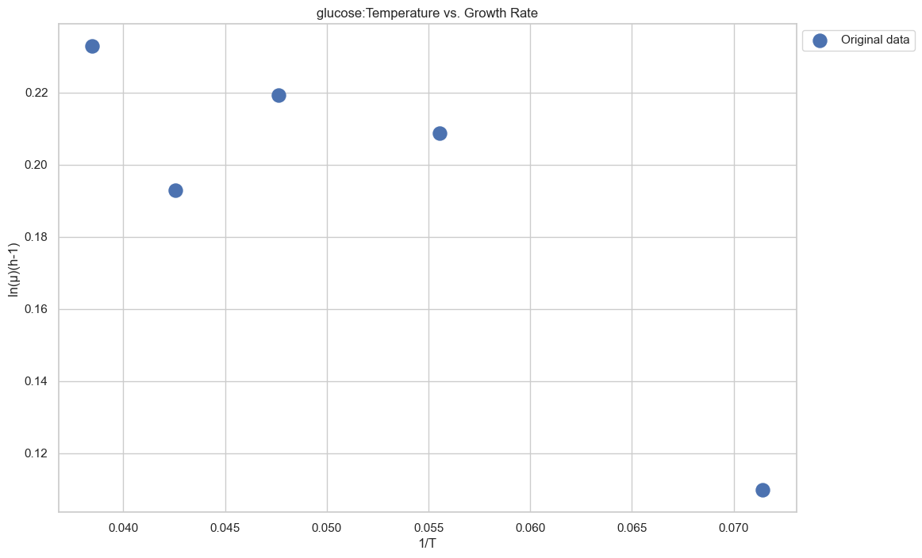
Examples for the extracted maximum per capita rate for 1A01
MB
Pyruvate
Glucose

Slide 10
The Analysis of Existing Dataset
This dataset was acquired in the context of Gralka et al. (2023) using a library of marine bacteria growth in 384-well plates in 4 incubators, with OD measured at least once per day over 4 days.
96 marine strains growth at four temperatures on a variety of carbon sources.
Collected at four different temperatures:12 °C, 17°C, 22 °C, 27 °C.
Each file contains ten sub-sheets corresponding to 9 types of carbon sources, plus a reference with no carbon source.
Matti Gralka, Shaul Pollak, and Otto X Cordero. 2023. Genome content predictsthe carbon catabolic preferences of heterotrophic bacteria. Nature Microbiology 8, 10 (2023), 1799–1808.
To supplement the growth measurements of 1A01 under different conditions, we used an existing data of 96 marine strains growth at four temperatures on a variety of carbon sources. This dataset was acquired in the context of [5] using a library of marine bacteria growth in 384-well plates in 4 incubators, with OD measured at least once per day over 4 days. The data files are collected at four different temperatures:12 °C, 17°C, 22 °C, 27 °C. Each file contains ten sub-sheets corresponding to nine types of carbon sources, plus a reference with no carbon source.

Slide 11
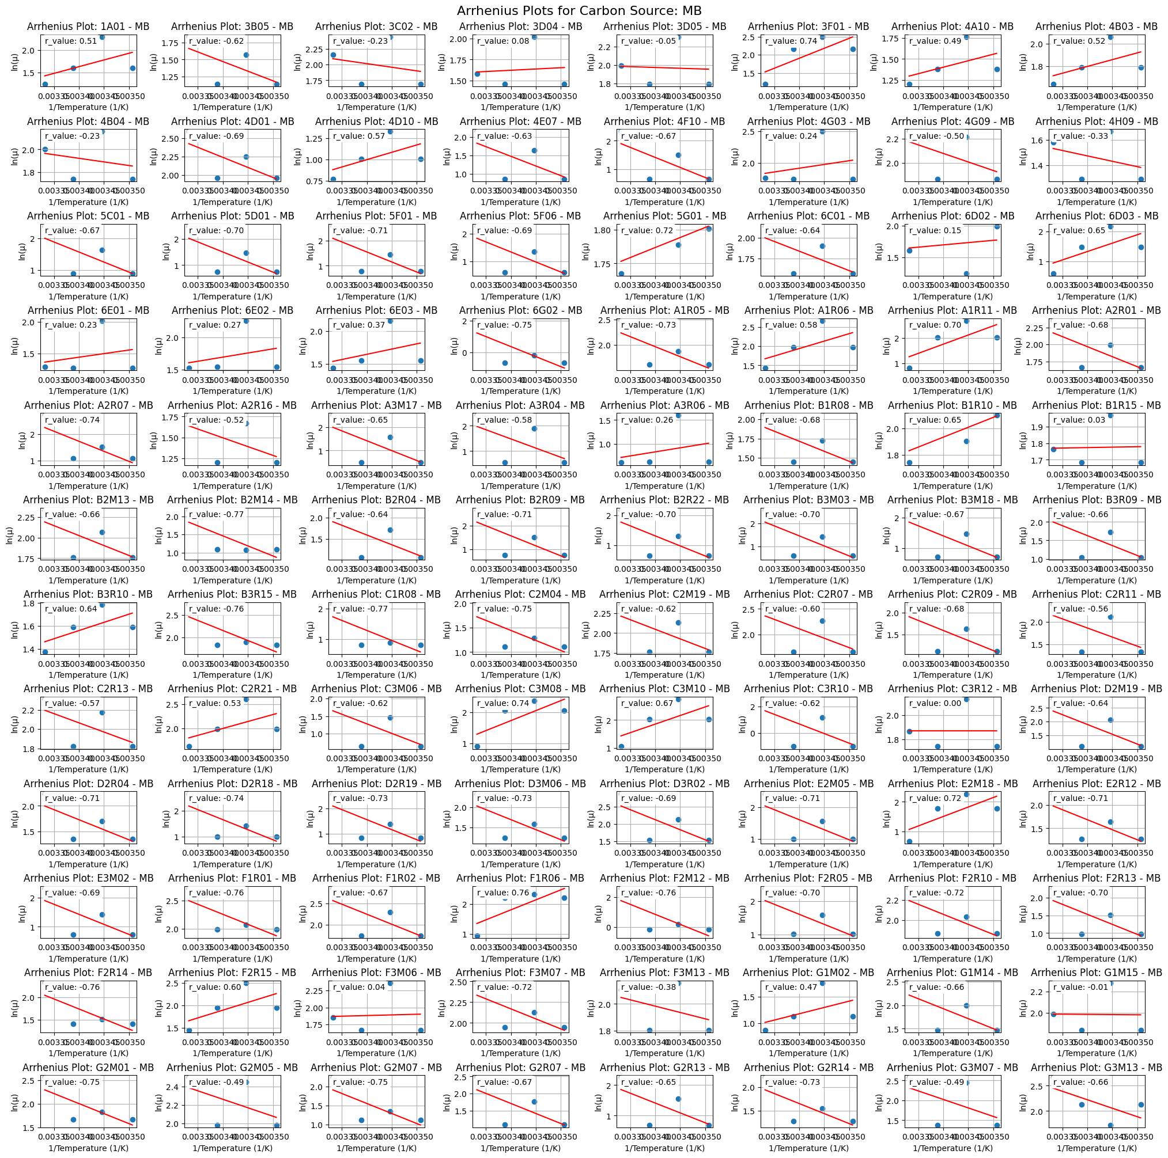
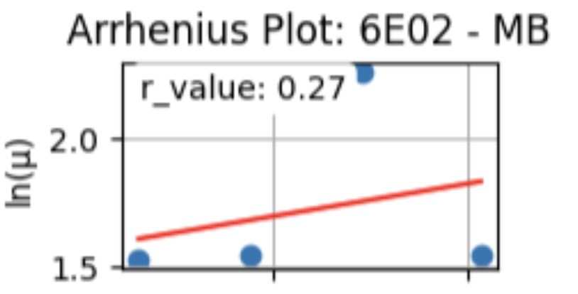
Modeling
Poor Modeling Fitting of extracting activation energy
10
ref: https://en.wikipedia.org/wiki/Arrhenius_equation

Slide 12
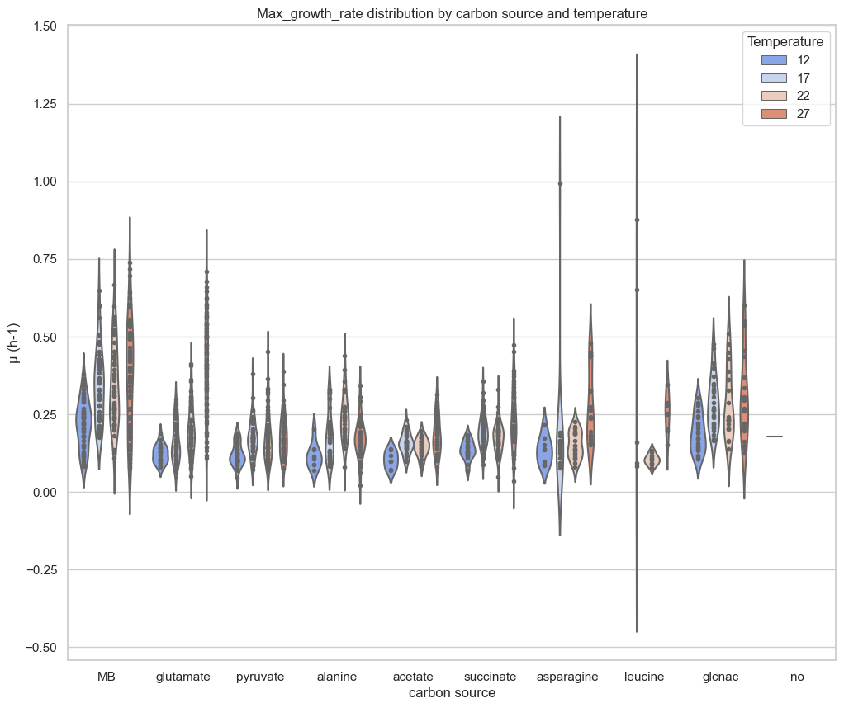
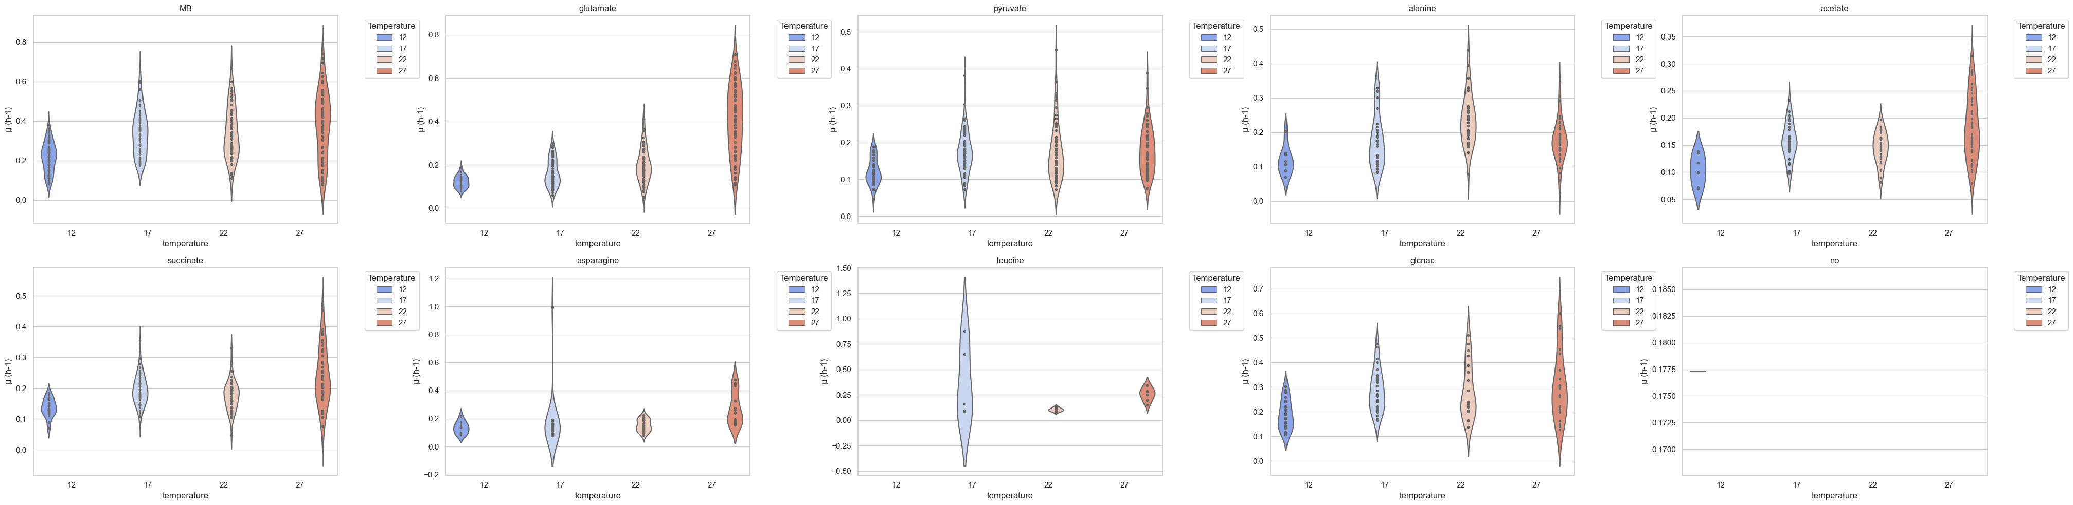
Look the general distribution From the Supplemented dara (Matti, 2023)
7
Matti Gralka, Shaul Pollak, and Otto X Cordero. 2023. Genome content predicts the carbon catabolic preferences of heterotrophic bacteria. Nature Microbiology 8, 10 (2023), 1799–1808.

Slide 13
Marine heterotrophic pryokaryotes
Organic Matter Degradation
(Polysaccharide...)
Nutrient Cycling
Environmental conditions
warmer
Colder
Cell Size
Cell cize
Growth rates
metabolic excretions

Slide 14
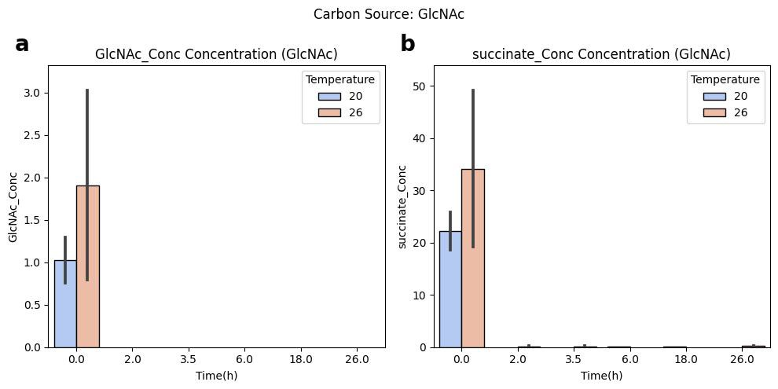
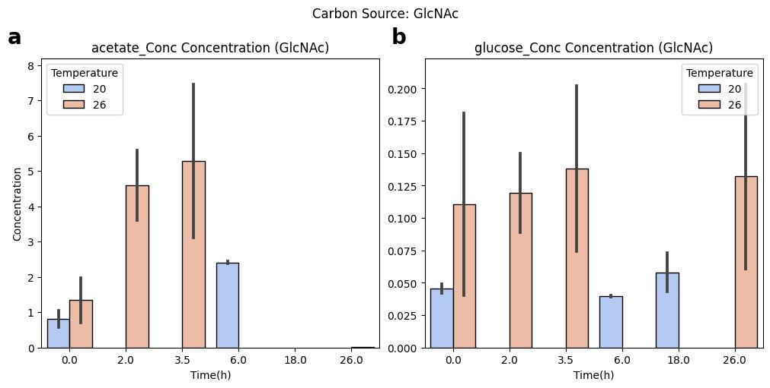
HPLC results for 1A01 grown on GlcNac and Glucose
Retention time of glcnac and succinate overlapping!
GlcNAc:14.647 minutes
Succinate:15.162 minutes

Slide 15
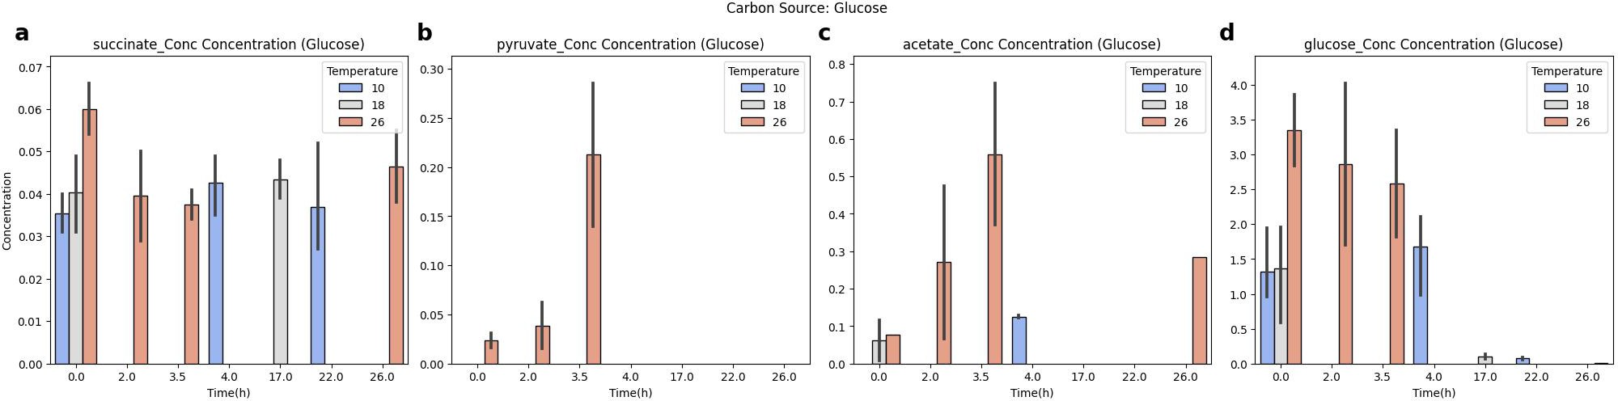

Measuring Growth Rates Growth of Monocultures
the highest detected excreted acetate concentration from GlcNAc is almost 9times higher compared to glucose at 26°C

Slide 16
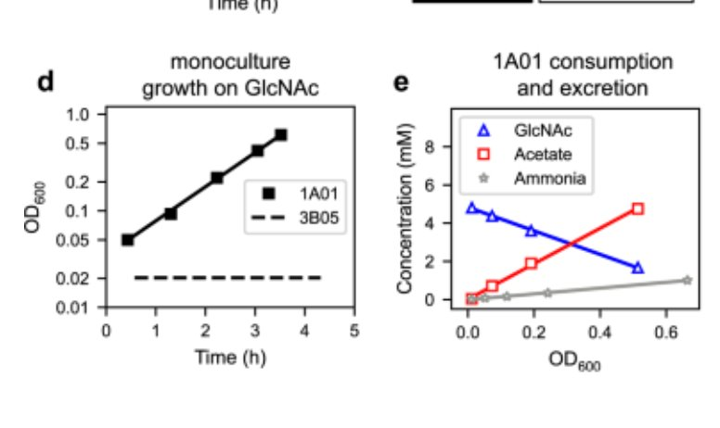

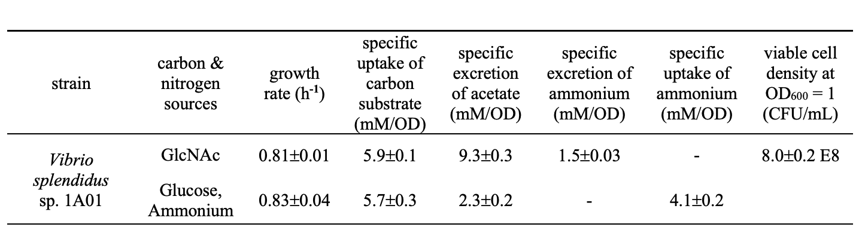
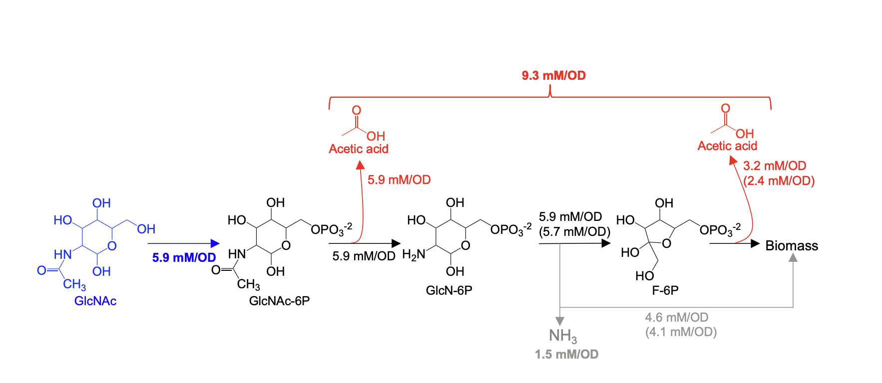
Consistent with Amarnath et al. (2023)
Vibrio splendidus strain 1A01
Monoculture steady-state physiological parameters for V. splendidus sp. 1A01 at 27˚C
Acetate Overflow
Amarnath, Kapil, et al. "Stress-induced metabolic exchanges between complementary bacterial types underly a dynamic mechanism of inter-species stress resistance." Nature communications 14.1 (2023): 3165.
The yield numbers in bold are based on the measurements during exponential growth . The numbers in regular text are deduced based on stoichiometry and the measured values. The numbers in parenthesis are numbers obtained from similar measurements during exponential growth of 1A01 on glucose and ammonium.
This analysis shows that growth yield on GlcNAc is similar to the yield on glucose and ammonium, so that the additional excretion of acetate and ammonium for the growth on GlcNAc compared to growth on glucose can be understood approximately as a result of the “extra” acetyl and amine groups accompanying the glucose in GlcNAc.
When metabolic processes produce more acetic acid than can be effectively used or incorporated into biomass, the excess acetic acid accumulates and is eventually excreted by the cell. This overflow phenomenon is a way for the cell to handle and dispose of excess metabolic byproducts.

Slide 17
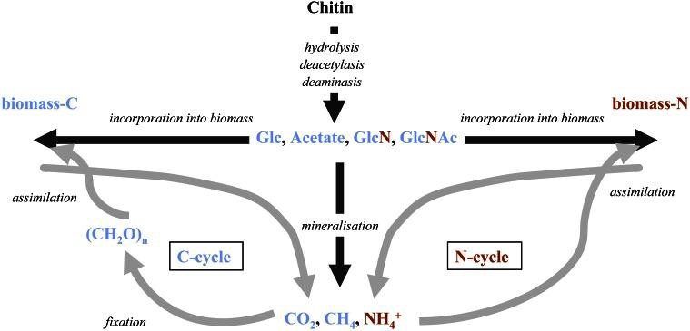

Chitinase Assay
chitin accounts for 20-58% of the dry weight of shellfish
after cellulose
chitin is the second most aboundant polysaccharide occuring in nature ​
Typically, around 75% of the total body weight of shellfish is discarded as waste, with
Notes:
Overall Breakdown Process:
Initial Hydrolysis:
Endochitinases initiate the breakdown by cleaving internal β-1,4 bonds in the chitin polymer, resulting in the formation of smaller oligosaccharides.
Further Hydrolysis:
Exochitinases act on the oligosaccharides, progressively releasing disaccharides (e.g., chitobiose) and monosaccharides (GlcNAc).
Final Hydrolysis:
β-N-acetylglucosaminidases complete the breakdown by hydrolyzing chitobiose and small oligosaccharides into GlcNAc monomers.
Chitin is another metabolic excretion we focused on due to its significant role. According to data from the shellfish processing industry, which deals with crab shells or shrimp, significant waste is generated from discarded shells. Typically, around 75% of the total body weight of shellfish is discarded as waste, with chitin accounts for 20-58% of that dry weight[14 ].Finding eco-friendly and cost-effective ways to utilize this waste is a focused subject. Marine bacteria are promising candidates for two reasons: they can help reduce environmental hazards by efficiently breaking down waste-bound chitin generated by the industry, thus offering a renewable raw material for valuable by-products. Additionally, traditional methods for processing chitin involve demineralization, deproteinization or hydrolysis using strong acid and bases, which are both inefficient and costly and pose corrosion problems[15 ]. Therefore, chitinolytic enzymes offer an ideal alternative. Conse- quently, V. splendidus 1A01 plays an ecological role in indicating the basis of microbial community assembly.From the chitinase results, we observed an unexpected phenomenon. We initially hypothe- sized that dividing chitinase activity by OD would show that each cell expresses the same amount of chitinase activity. However, the results indicate that even when normalized by OD, there is still a correlation between higher initial OD and higher chitinase activity

Slide 18

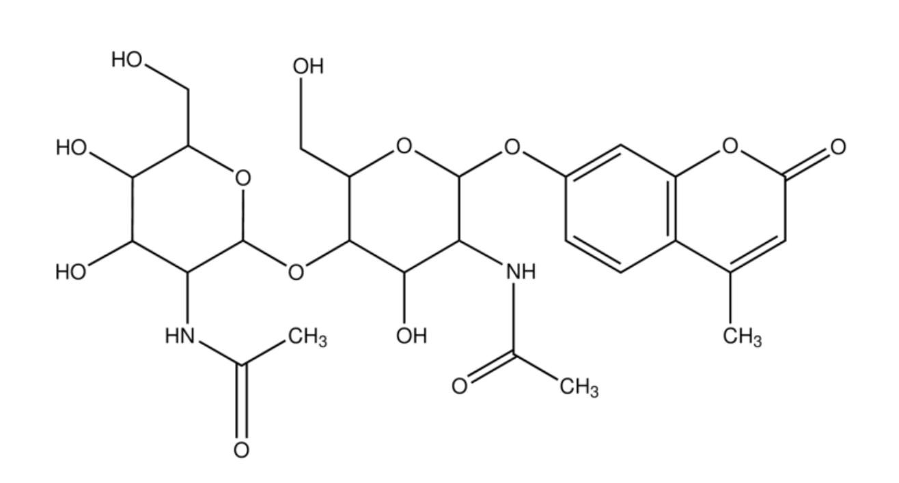
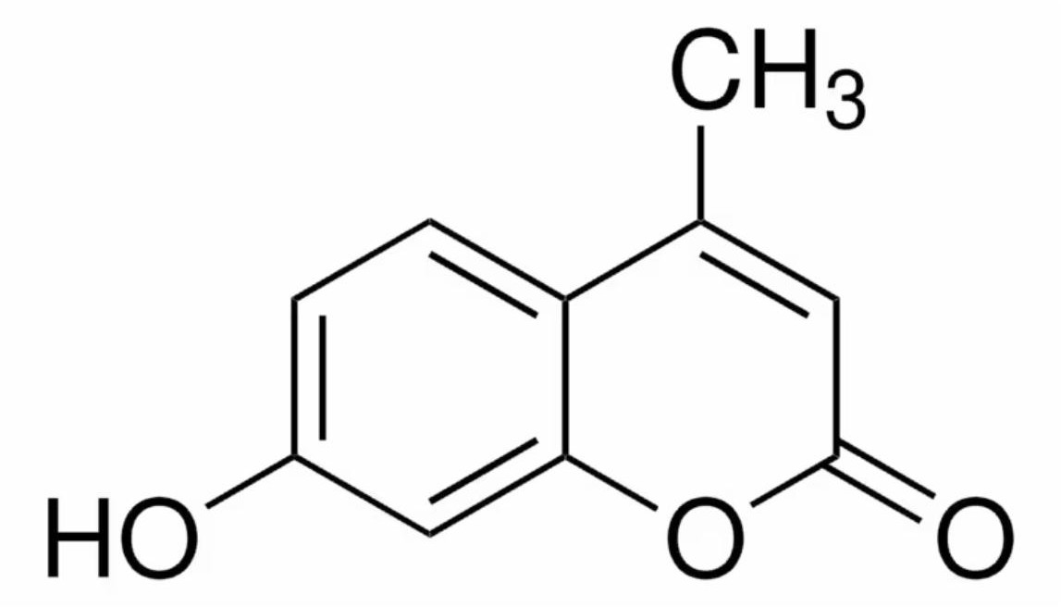
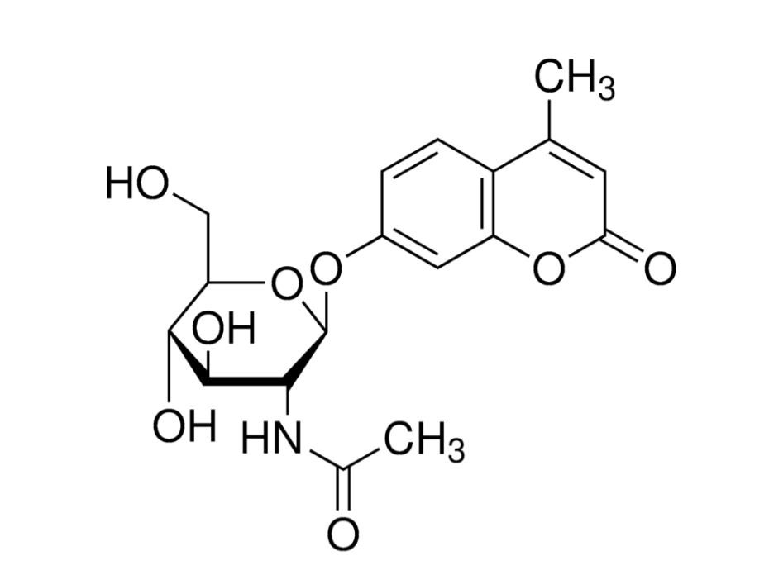

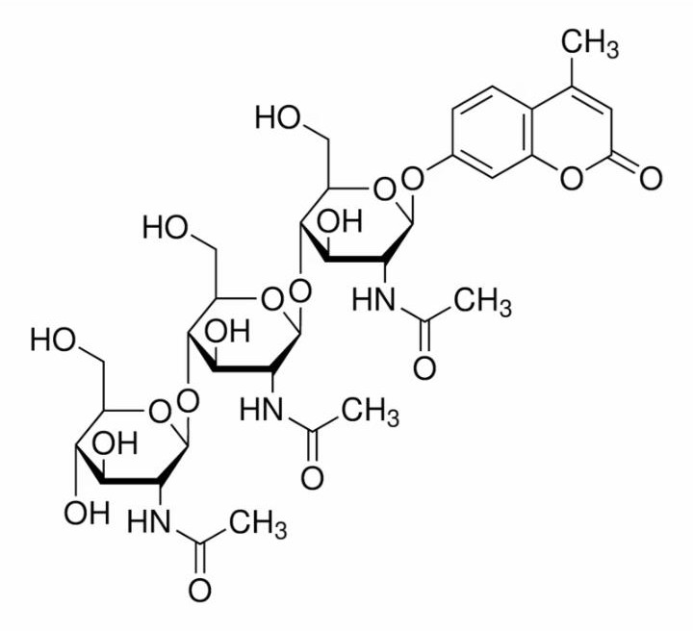


Chitinase Kit
sub2
detecting chitobiosidase
· 4-MU
(4-Methylumbelliferone)
sub1
detecting N-acetyl-
-D-glucosaminide
· detecting exochitinase activity
· 4-Methylumbelliferyl -D N,N,N_x0002_triacetylchitotriose(sub3)
detecting endochitinase activity
13
https://www.sigmaaldrich.com/SG/en/product/sigma/m5639
Notes:
Overall Breakdown Process:
Initial Hydrolysis:
Endochitinases initiate the breakdown by cleaving internal β-1,4 bonds in the chitin polymer, resulting in the formation of smaller oligosaccharides.
Further Hydrolysis:
Exochitinases act on the oligosaccharides, progressively releasing disaccharides (e.g., chitobiose) and monosaccharides (GlcNAc).
Final Hydrolysis:
β-N-acetylglucosaminidases complete the breakdown by hydrolyzing chitobiose and small oligosaccharides into GlcNAc monomers.

Slide 19
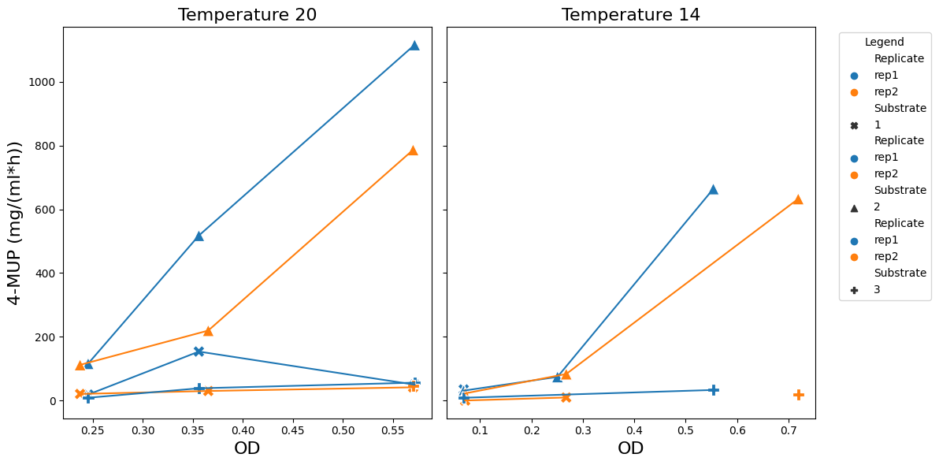
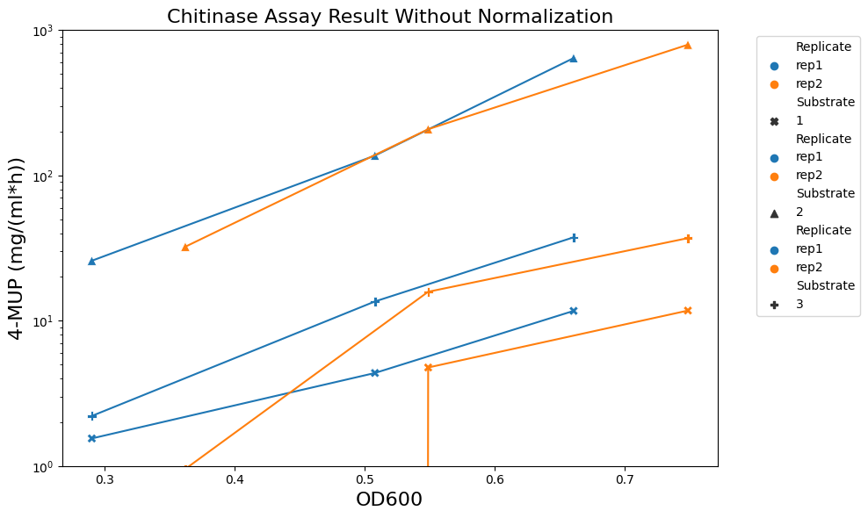
Chtinase result for 1A01 at varing temperature
Repeat Experiment at 20˚C

Slide 20
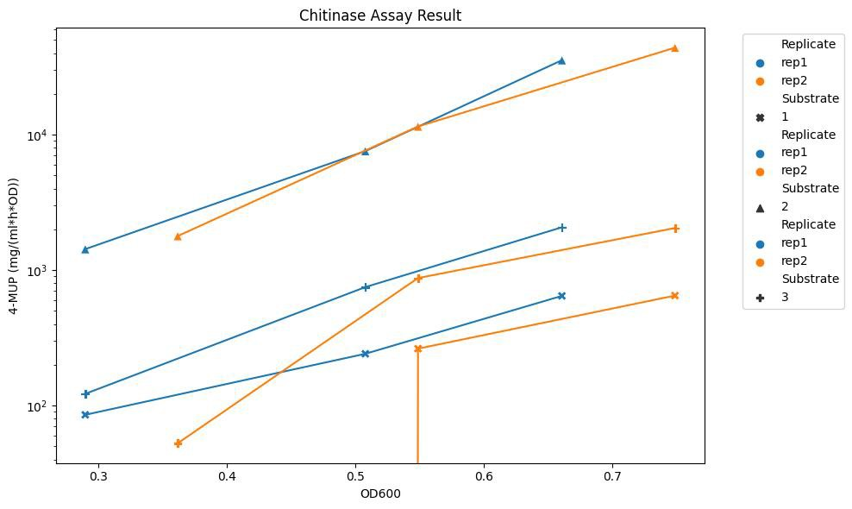

My Expectation
After OD Normalization
sub2
sub3
sub1
18

Slide 21

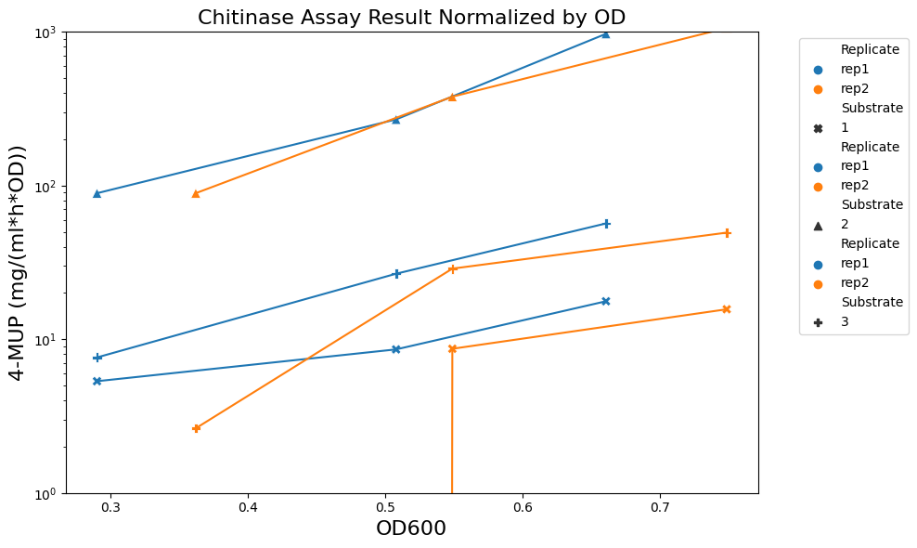
Reality
Higher OD, higher chitinase activity per cell!
18

Slide 22
Core Message
Both media composition and temperature significantly impact the physiology of the studied strains.
When growth rate increases with rising temperatures, the cell size tends to become smaller. Media composition also plays an important role in determining cell size.
The strain 1A01 has a higher growth yield on sugars compared to acids.
Higher bacterial density produces higher chitinase activity per cell.
Notes:
Media Composition and Temperature Effects:
Both media composition and temperature significantly impact the physiology of the studied strains.
Growth Rate and Cell Size:
When growth rate increases with rising temperatures, the cell size tends to become smaller. Media composition also plays an important role in determining cell size.
1A01 Growth Yield:
The strain 1A01 has a higher growth yield on sugars compared to acids.
Temperature and Growth Rates:
Increasing temperatures generally improve bacterial growth rates in most marine strains. However, the strains' behavior varies with different carbon sources.
Chitinase Activity:
Higher bacterial density produces higher chitinase activity per cell.
Acetate Excretion:
When 1A01 grows on GlcNAc, it excretes around ten times more acetate than when it grows on glucose. It also has a strong ability to utilize acetate to support its growth and relieve acid stress.

Slide 23

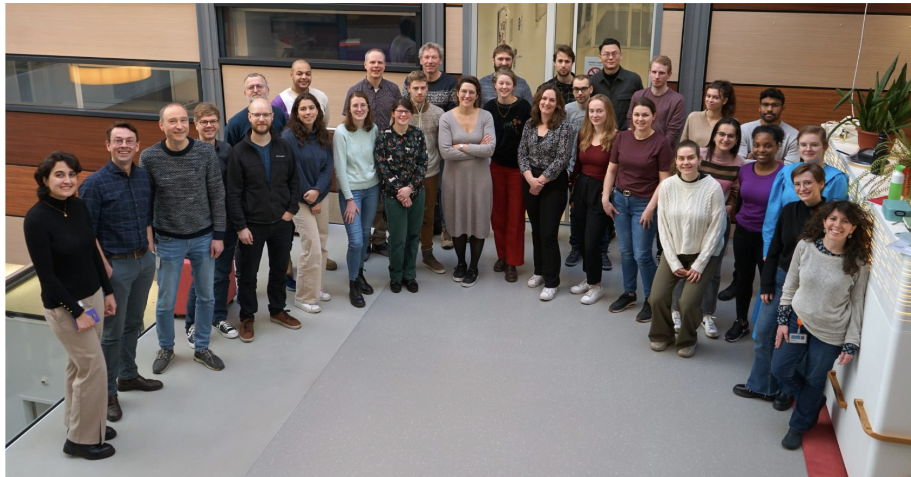
Thank you!

